Slide 1
Sequences and Series
Precalculus
Chapter 10

Slide 2
This Slideshow was developed to accompany the textbook
  Precalculus
  By Richard Wright
  https://www.andrews.edu/~rwright/Precalculus-RLW/Text/TOC.html
Some examples and diagrams are taken from the textbook.
Slides created by
Richard Wright, Andrews Academy
rwright@andrews.edu

Slide 3
10-01 Sequences
In this section, you will:
Write a sequence from a rule.
Write an explicit rule for a sequence.
Write a recursive rule for a sequence.
Simplify factorial expressions.

Slide 4

10-01 Sequences
Sequence
  List of numbers following a rule
  0, 3, 6, 9, 12 <− finite (ends)
  0, 3, 6, 9, 12, … <− infinite (doesn’t end)
  $n=1, 2, 3, 4, 5, …$ (term #) like x
  $a_{n}=0, 3, 6, 9, 12, …$ (term value) like y

Slide 5

10-01 Sequences
Find the 1st 5 terms of $a_{n}=5+2n{\left(−1\right)}^{n}$
Notes:
$$a_{1}=5+2\left(1\right){\left(−1\right)}^{1}=3$$
$$a_{2}=5+2\left(2\right){\left(−1\right)}^{2}=9$$
$$a_{3}=5+2\left(3\right){\left(−1\right)}^{3}=−1$$
$$a_{4}=5+2\left(4\right){\left(−1\right)}^{4}=13$$
$$a_{5}=5+2\left(5\right){\left(−1\right)}^{5}=−5$$

Slide 6
10-01 Sequences
Write the rule for the n^{th} term.
1, 5, 9, 13, 17, …
2, -9, 28, -65, 126, …
Notes:
$$a_{n}=4n−3$$
$$a_{n}={\left(−1\right)}^{n+1}(n^{3}+1)$$

Slide 7
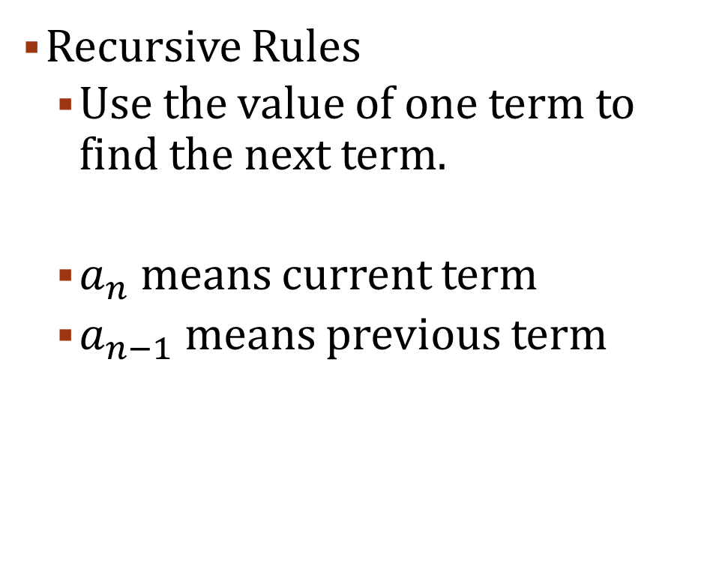

10-01 Sequences
Recursive Rules
  Use the value of one term to find the next term.
  $a_{n}$ means current term
  $a_{n−1}$ means previous term
Find the first 5 terms.
  $a_{1}=6$
  $a_{n}=a_{n−1}+1$
Notes:
$$a_{1}=6$$
$$a_{2}=a_{1}+1=6+1=7$$
$$a_{3}=a_{2}+1=7+1=8$$
$$a_{4}=a_{3}+1=8+1=9$$
$$a_{5}=a_{4}+1=9+1=10$$

Slide 8

10-01 Sequences
Factorial (!)
  Product of a whole number with all the whole numbers less than it through 1.
  6! = 6 ∙ 5 ∙ 4 ∙ 3 ∙ 2 ∙ 1
  5! = 5 ∙ 4 ∙ 3 ∙ 2 ∙ 1
  0! = 1
Simplify
$\frac{9!}{3!7!}$
Notes:
$$\frac{9!}{3!7!}$$
$$\frac{9∙8∙7∙6∙5∙4∙3∙2∙1}{3∙2∙1∙7∙6∙5∙4∙3∙2∙1}$$
$$\frac{9∙8}{3∙2∙1}$$
$$\frac{72}{6}$$
$$12$$

Slide 9

10-01 Sequences
Simplify
$\frac{\left(n+1\right)!}{n!}$
Notes:
$$\frac{\left(n+1\right)!}{n!}$$
$$\frac{\left(n+1\right)\left(n\right)\left(n−1\right)\left(n−2\right)⋯}{\left(n\right)\left(n−1\right)\left(n−2\right)⋯}$$
$$n+1$$

Slide 10
10-02 Series
In this section, you will:
Evaluate a summation.
Write a series as a summation.

Slide 11
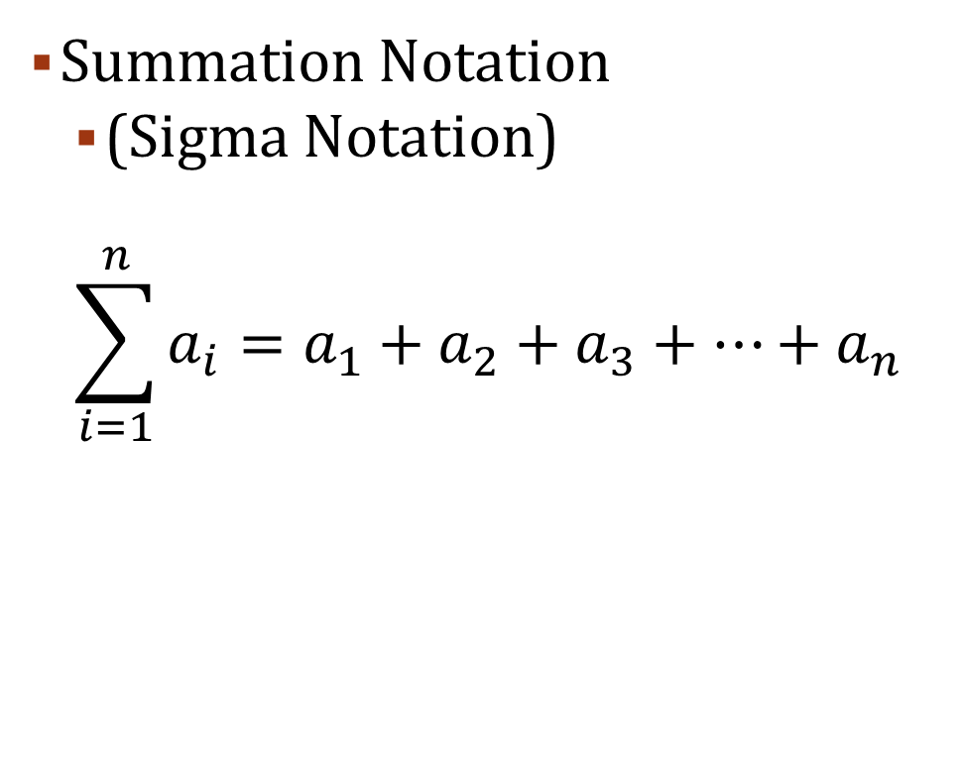
10-02 Series
Series
  Sum of a sequence
  Sequence
    2, 4, 6, 8
  Series
    2 + 4 + 6 + 8
Summation Notation
  (Sigma Notation)
  $$\sum_{i=1}^{n}{a_{i}}=a_{1}+a_{2}+a_{3}+⋯+a_{n}$$
Notes:
i = index
1 = lower limit
n = upper limit

Slide 12


10-02 Series
Find each sum
$$\sum_{i=1}^{4}{(4i+1)}$$
$$\sum_{k=2}^{5}{\left(2+k^{3}\right)}$$
Notes:
$$\sum_{i=1}^{4}{(4i+1)}=\left(4\left(1\right)+1\right)+\left(4\left(2\right)+1\right)+\left(4\left(3\right)+1\right)+\left(4\left(4\right)+1\right)$$
$$=5+9+13+17=44$$
$$\sum_{k=2}^{5}{(2+k^{3})}=\left(2+2^{3}\right)+\left(2+3^{3}\right)+\left(2+4^{3}\right)+\left(2+5^{3}\right)$$
$$=10+29+66+27=232$$

Slide 13

10-02 Series
$$\sum_{n=1}^{∞}{\frac{5}{{10}^{n}}}$$
Notes:
$$\sum_{n=1}^{∞}{\frac{5}{{10}^{n}}}$$
Parital sums
$$\frac{5}{{10}^{1}}=0.5$$
$$\frac{5}{{10}^{1}}+\frac{5}{{10}^{2}}=0.5+0.05=0.55$$
$$\frac{5}{{10}^{1}}+\frac{5}{{10}^{2}}+\frac{5}{{10}^{3}}=0.5+0.05+0.005=0.555$$
$$\frac{5}{{10}^{1}}+\frac{5}{{10}^{2}}+\frac{5}{{10}^{3}}+\frac{5}{{10}^{4}}=0.5+0.05+0.005+0.0005=0.5555$$
Approaches
$$0.55555555555…=\frac{5}{9}$$

Slide 14

10-02 Series
Shortcut formulas
$$1+1+1+1+⋯=\sum_{i=1}^{n}{1}=n$$
$$1+2+3+4+⋯=\sum_{i=1}^{n}{i}=\frac{n\left(n+1\right)}{2}$$
$$1+4+9+16+⋯=\sum_{i=1}^{n}{i^{2}}=\frac{n\left(n+1\right)\left(2n+1\right)}{6}$$

Slide 15

10-02 Series
$$1+8+27+64+⋯=\sum_{i=1}^{n}{i^{3}}=\frac{n^{2}{\left(n+1\right)}^{2}}{4}$$
$$1+16+81+256+⋯=\sum_{i=1}^{n}{i^{4}}=\frac{n\left(n+1\right)\left(2n+1\right)\left(3n^{2}+3n−1\right)}{30}$$
$$1+32+243+1024+⋯=\sum_{i=1}^{n}{i^{5}}=\frac{n^{2}{\left(n+1\right)}^{2}\left(2n^{2}+2n−1\right)}{12}$$

Slide 16

10-02 Series
Evaluate
$$\sum_{i=1}^{5}{\left(3i^{2}−5i\right)}$$
Notes:
$$\sum_{i=1}^{5}{3i^{2}}−\sum_{i=1}^{5}{5i}$$
$$=3\left(\frac{n\left(n+1\right)\left(2n+1\right)}{6}\right)−5\left(\frac{n\left(n+1\right)}{2}\right)$$
$$=3\left(\frac{5\left(5+1\right)\left(2\left(5\right)+1\right)}{6}\right)−5\left(\frac{5\left(5+1\right)}{2}\right)$$
$$=90$$

Slide 17
10-03 Arithmetic Sequences and Series
In this section, you will:
Write the explicit rule for an arithmetic sequence.
Write the recursive rule for an arithmetic sequence.
Evaluate the sum for an arithmetic series.

Slide 18

10-03 Arithmetic Sequences and Series
Arithmetic
  Common difference (d)
3, 7, 11, 15, 19, …
Rule for the n^{th} term
$a_{n}=dn+c$
  Where $c=a_{1}−d$
$a_{n}=a_{1}+\left(n−1\right)d$

Slide 19
10-03 Arithmetic Sequences and Series
Find the rule for the n^{th} term for 3, 7, 11, 15, 19, …
Notes:
d = 7 – 3 = 4; 11 – 7 = 4, 15 – 11 = 4; 19 – 15 = 4
a₁ = 3
$$a_{n}=a_{1}+\left(n−1\right)d$$
$$a_{n}=3+\left(n−1\right)4$$
$$a_{n}=3+4n−4$$
$$a_{n}=4n−1$$

Slide 20
10-03 Arithmetic Sequences and Series
The 8th term of an arithmetic sequence is 25, and the 12th term is 41. Write the rule for the n^{th} term.
Notes:
$$a_{n}=a_{1}+\left(n−1\right)d$$
Fill in $a_{8}=25$
$$25=a_{1}+\left(8−1\right)d$$
$$25=a_{1}+7d$$
Fill in $a_{12}=41$
$$41=a_{1}+\left(12−1\right)d$$
$$41=a_{1}+11d$$
Solve system of eq.
$$−25={−a}_{1}−7d \\ 41=a_{1}+11d \\ 16= 4d$$
$$4=d$$
$$25=a_{1}+7\left(4\right)$$
$$a_{1}=−3$$
$$a_{n}=−3+\left(n−1\right)4$$
$$a_{n}=4n−7$$

Slide 21

10-03 Arithmetic Sequences and Series
Recursive Rule for Arithmetic Sequences
$a_{1}=a_{1}$
$a_{n}=a_{n−1}+d$

Slide 22

10-03 Arithmetic Sequences and Series
Arithmetic Series
$1+3+5+7+9+11+13+15+17+19$
$1 + 3+ 5+ 7+ 9$
$19+17+15+13+11$
$20+20+20+20+20=5\left(20\right)=100$
$S_{n}=\frac{n}{2}\left(a_{1}+a_{n}\right)$

Slide 23
10-03 Arithmetic Sequences and Series
Find the sum of the integers 1 to 57.
Notes:
$$1+2+3+4+⋯+57$$
d = 1; a₁ = 1; a_{n} = 57
$$S_{n}=\frac{n}{2}\left(a_{1}+a_{n}\right)$$
$$S_{57}=\frac{57}{2}\left(1+57\right)$$
$$S_{57}=\frac{57}{2}\left(58\right)=1653$$

Slide 24
10-03 Arithmetic Sequences and Series
Find the 50th partial sum of the arithmetic sequence -6, -2, 2, 6, …
Notes:
d = 4; a₁ = -6
Find n^{th} term to get a_{n}
$$a_{n}=a_{1}+\left(n−1\right)d$$
$$a_{n}=−6+\left(n−1\right)4$$
$$a_{n}=4n−10$$
$$a_{50}=4\left(50\right)−10=190$$
Find the sum
$$S_{n}=\frac{n}{2}(a_{1}+a_{n})$$
$$S_{50}=\frac{50}{2}\left(−6+190\right)=4600$$

Slide 25

10-03 Arithmetic Sequences and Series
Evaluate
$$\sum_{i=1}^{100}{(3i+2)}$$
Notes:
Linear (in form of $a_{n}=dn+c$) so arithmetic
$$S_{n}=\frac{n}{2}\left(a_{1}+a_{n}\right)$$
$$S_{100}=\frac{100}{2}\left(\left(3\left(1\right)+2\right)+\left(3\left(100\right)+2\right)\right)$$
$$=50\left(5+302\right)$$
$$=15350$$

Slide 26
10-04 Geometric Sequences and Series
In this section, you will:
Write the explicit rule for a geometric sequence.
Write the recursive rule for a geometric sequence.
Evaluate the sum for a geometric series.

Slide 27


10-04 Geometric Sequences and Series
Geometric
  Common ratio (r)
1, 3, 9, 27, 81, 243, …
Rule for n^{th} term
$a_{n}=a_{1}r^{n−1}$
Find the rule for $6, −2,\frac{2}{3}, …$
Notes:
$$r=−\frac{2}{6}=−\frac{1}{3}$$
$$a_{n}=a_{1}r^{n−1}$$
$$a_{n}=6{\left(−\frac{1}{3}\right)}^{n−1}$$

Slide 28
10-04 Geometric Sequences and Series
The 2nd term of a geometric sequence is -18, the 5th term is 2/3. Find the rule for the n^{th} term.
Notes:
$$a_{n}=a_{1}r^{n−1}$$
Fill in $a_{2}=−18$
$$−18=a_{1}r^{\left(2−1\right)}$$
$$−18=a_{1}r$$
$$a_{1}=−\frac{18}{r}$$
Fill in $a_{5}=\frac{2}{3}$
$$\frac{2}{3}=a_{1}r^{5−1}$$
$$\frac{2}{3}=a_{1}r^{4}$$
Substitute
$$\frac{2}{3}=−\frac{18}{r}r^{4}$$
$$\frac{2}{3}=−18r^{3}$$
$$−\frac{1}{27}=r^{3}$$
$$−\frac{1}{3}=r$$
Substitute
$$−\frac{18}{−\frac{1}{3}}=a_{1}$$
$$a_{1}=54$$
$$a_{n}=54{\left(−\frac{1}{3}\right)}^{n−1}$$

Slide 29


10-04 Geometric Sequences and Series
Geometric Series
$S_{n}=a_{1}\left(\frac{1−r^{n}}{1−r}\right)$
$S_{∞}=\frac{a_{1}}{1−r}$
  Where $\left|r\right|<1$
Evaluate
$$\sum_{n=1}^{7}{2^{n−1}}$$
Notes:
$2^{n−1}$ is in the form $a_{1}r^{n−1}$ where $a_{1}=1$ and $r=2$
$$S_{n}=a_{1}\left(\frac{1−r^{n}}{1−r}\right)$$
$$S_{7}=1\left(\frac{1−2^{7}}{1−2}\right)=127$$

Slide 30


10-04 Geometric Sequences and Series
Evaluate
$5+0.5+0.05+0.005+⋯$
$$\sum_{n=0}^{∞}{5{\left(\frac{1}{2}\right)}^{n}}$$
Notes:
$a_{1}=5$ and $r=\frac{1}{10}$
$$S_{∞}=\frac{a_{1}}{1−r}$$
$$=\frac{5}{1−\frac{1}{10}}$$
$$=\frac{5}{\frac{9}{10}}=5\left(\frac{10}{9}\right)=\frac{50}{9}$$
The lower limit is not 1, so calculate n = 0
$$5{\left(\frac{1}{2}\right)}^{0}+\sum_{n=1}^{∞}{5{\left(\frac{1}{2}\right)}^{n}}$$
The exponent is not n-1, so multiply and divide by ½
$$5+\sum_{n=1}^{∞}{5\left(\frac{1}{2}\right)\frac{{\left(\frac{1}{2}\right)}^{n}}{\frac{1}{2}}}$$
$$5+\sum_{n=1}^{∞}{\left(\frac{5}{2}\right){\left(\frac{1}{2}\right)}^{n−1}}$$
$a_{1}=\frac{5}{2}$ and $r=\frac{1}{2}$
$$S_{∞}=\frac{a_{1}}{1−r}$$
$$5+\left(\frac{\frac{5}{2}}{1−\frac{1}{2}}\right)$$
$$5+\left(\frac{\frac{5}{2}}{\frac{1}{2}}\right)$$
$$5+5=10$$

Slide 31
10-05 Mathematical Induction
In this section, you will:
Write a proof for a sum formula using mathematical induction.
Prove other mathematical statements using mathematical induction.

Slide 32

10-05 Mathematical Induction
Proofs for sum formulas
  Show it works when n = 1
  Show it works for n + 1
Steps
Show it works for n = 1
Assume formula works for $n=k$
Show it works for $n=k+1$
  If proving sum formula use $S_{k+1}=S_{k}+a_{k+1}$

Slide 33

10-05 Mathematical Induction
Prove $5+7+9+11+13+⋯+\left(3+2n\right)=n\left(n+4\right)$
Notes:
This is in the form $a_{1}+a_{2}+a_{3}+⋯+a_{n}=S_{n}$, so
$$a_{n}=3+2n$$
$$S_{n}=n\left(n+4\right)$$
$S_{1}=1\left(1+4\right)=5=a_{1}$
Assume $S_{k}=k\left(k+4\right)$
$S_{k+1}=S_{k}+a_{k+1}$
$$\left(k+1\right)\left(\left(k+1\right)+4\right)=k\left(k+4\right)+\left(3+2\left(k+1\right)\right)$$
$$\left(k+1\right)\left(k+5\right)=k^{2}+4k+3+2k+2$$
$$k^{2}+6k+5=k^{2}+6k+5$$

Slide 34

10-05 Mathematical Induction
Prove $1\left(1−1\right)+2\left(2−1\right)+3\left(3−1\right)+⋯+n\left(n−1\right)=\frac{n\left(n−1\right)\left(n+1\right)}{3}$
Notes:
This is in the form $a_{1}+a_{2}+a_{3}+⋯+a_{n}=S_{n}$, so
$$a_{n}=n(n−1)$$
$$S_{n}=\frac{n\left(n−1\right)\left(n+1\right)}{3}$$
$S_{1}=\frac{1\left(1−1\right)\left(1+1\right)}{3}=0=a_{1}$
Assume $S_{k}=\frac{k\left(k−1\right)\left(k+1\right)}{3}$
$S_{k+1}=S_{k}+a_{k+1}$
$$\frac{\left(k+1\right)\left(\left(k+1\right)−1\right)\left(\left(k+1\right)+1\right)}{3}=\frac{k\left(k−1\right)\left(k+1\right)}{3}+\left(k+1\right)\left(\left(k+1\right)−1\right)$$
$$\frac{\left(k+1\right)\left(k\right)\left(k+2\right)}{3}=\frac{k^{3}−k}{3}+k^{2}+k$$
$$\frac{k^{3}+3k^{2}+2k}{3}=\frac{k^{3}−k}{3}+\frac{3k^{2}}{3}+\frac{3k}{3}$$
$$\frac{k^{3}+3k^{2}+2k}{3}=\frac{k^{3}+3k^{2}+2k}{3}$$

Slide 35

10-05 Mathematical Induction
Prove $\left(n+1\right)!>2^{n}$ where $n≥2$
Notes:
$n=2$: $\left(2+1\right)!>2^{2}$
$3!>4$
$6>4$
Assume $\left(k+1\right)!>2^{k}$
Show $n=k+1$: $\left(\left(k+1\right)+1\right)!>2^{k+1}$
$\left(k+2\right)!>2^{k+1}$
$\left(k+2\right)\left(k+1\right)!>2^{k}∙2$
$\left(k+2\right)>2$ always and $\left(k+1\right)!>2^{k}$ was true from step 2, so whole thing true.

Slide 36

10-05 Mathematical Induction
Prove 4 is a factor of $5^{n}−1$
Notes:
$n=1$: $5^{1}−1=4$; 4 is a factor of 4
Assume 4 is a factor of $5^{k}−1$
$n=k+1$
$5^{k+1}−1$
$5^{k+1}−5^{k}+5^{k}−1$
$\left(5^{k}∙5−5^{k}\right)+\left(5^{k}−1\right)$
$5^{k}\left(5−1\right)+\left(5^{k}−1\right)$
$4∙5^{k}+\left(5^{k}−1\right)$
4 is factor of both $4∙5^{k}$ and $(5^{k}−1)$

Slide 37
10-06 Binomial Theorem
In this section, you will:
Evaluate combinations.
Expand binomial expressions.

Slide 38

10-06 Binomial Theorem
(x + y)⁰ 1
(x + y)¹ 1x 1y
(x + y)² 1x² 2xy 1y²
(x + y)³ 1x³ 3x²y 3xy² 1y³
(x + y)⁴ 1x⁴ 4x³y 6x²y² 4xy³ 1y⁴
Properties
1. n + 1 terms
2. Powers of x count down, y’s count up
3. Sum of exponents of each term = n
4. Coefficients are symmetrical
$${{}_{n}^{}C}_{r}$$
Notes:
Rows are n starting at 0
Down to left diagonals are r starting at 0
nCr is the coefficient of the row and diagonal

Slide 39


10-06 Binomial Theorem
Binomial theorem
$${\left(a+b\right)}^{n}=\sum_{r=0}^{n}{{{}_{n}^{}C}_{r}a^{n−r}b^{r}}$$
Where ${{}_{n}^{}C}_{r}=\frac{n!}{\left(n−r\right)!r!}$
Evaluate
${{}_{9}^{}C}_{2}$
$\left(\begin{matrix}11 \\ 4\end{matrix}\right)$
$\left(\begin{matrix}8 \\ 8\end{matrix}\right)$
$\left(\begin{matrix}4 \\ 2\end{matrix}\right)$
Notes:
On TI graphing calc: MATH → PRB | nCr
$${{}_{9}^{}C}_{2}$$
Type 9 nCr 2 = 36
$$\left(\begin{matrix}11 \\ 4\end{matrix}\right)={{}_{11}^{}C}_{4}=330$$
$$\left(\begin{matrix}8 \\ 8\end{matrix}\right)={{}_{8}^{}C}_{8}=1$$
$$\left(\begin{matrix}4 \\ 2\end{matrix}\right)={{}_{4}^{}C}_{2}=6$$

Slide 40

10-06 Binomial Theorem
Expand ${\left(x+2\right)}^{4}$
Notes:
a = x; b = 2; n = 4
$$\sum_{r=0}^{n}{{{}_{n}^{}C}_{r}a^{n−r}b^{r}}$$
$${{}_{4}^{}C}_{0}x^{4}2^{0}+{{}_{4}^{}C}_{1}x^{3}2^{1}+{{}_{4}^{}C}_{2}x^{2}2^{2}+{{}_{4}^{}C}_{3}x^{1}2^{3}+{{}_{4}^{}C}_{4}x^{0}2^{4}$$
$$1∙x^{4}∙1+4∙x^{3}∙2+6∙x^{2}∙4+4∙x∙8+1∙1∙16$$
$$x^{4}+8x^{3}+24x^{2}+32x+16$$

Slide 41

10-06 Binomial Theorem
Expand ${\left(3−x^{2}\right)}^{5}$
Notes:
a = 3; b = $−x^{2}$; n = 5
$$\sum_{r=0}^{n}{{{}_{n}^{}C}_{r}a^{n−r}b^{r}}$$
$${{}_{5}^{}C}_{0}3^{5}{\left(−x^{2}\right)}^{0}+{{}_{5}^{}C}_{1}3^{4}{\left(−x^{2}\right)}^{1}+{{}_{5}^{}C}_{2}3^{3}{\left(−x^{2}\right)}^{2}+{{}_{5}^{}C}_{3}3^{2}{\left(−x^{2}\right)}^{3}+{{}_{5}^{}C}_{4}3^{1}{\left(−x^{2}\right)}^{4}+{{}_{5}^{}C}_{5}3^{0}{\left(−x^{2}\right)}^{5}$$
$$1∙243∙1+5∙81∙\left(−x^{2}\right)+10∙27∙x^{4}+10∙9∙\left(−x^{6}\right)+5∙3∙x^{8}+1∙1∙\left(−x^{10}\right)$$
$$243−405x^{2}+270x^{4}−90x^{6}+15x^{8}−x^{10}$$

Slide 42

10-06 Binomial Theorem
Find the coefficient of the term $a^{4}b^{7}$ in ${\left(2a−3b\right)}^{11}$
Notes:
a = 2a; b = -3b; n = 11
$$\sum_{r=0}^{n}{{{}_{n}^{}C}_{r}a^{n−r}b^{r}}$$
Compare this to $a^{4}b^{7}$ to see that r = 7
$${{}_{11}^{}C}_{7}{\left(2a\right)}^{11−7}{\left(−3b\right)}^{7}$$
$$330\left(16a^{4}\right)\left(−2187b^{7}\right)$$
$$−11,547,360a^{4}b^{7}$$
-11,547,360

Slide 43
10-07 Counting Principles
In this section, you will:
Apply the fundamental counting principle
Calculate permutations
Calculate combinations

Slide 44
10-07 Counting Principles
Fundamental Counting Principle
  If events E₁ and E₂ occur in m₁ and m₂ ways, the number of ways both events can occur is m₁∙m₂.
A lock will open with the right choice of 3 numbers. How many different sets of 3 numbers can you choose if each number is from 1 to 30 inclusive? (a) with repetition (b) without repetition
Notes:
30∙30∙30 = 27000
30∙29∙28 = 24360

Slide 45
10-07 Counting Principles
How many license plates can be made if each is 2 letters follow by 4-digits? (a) with repetition (b) without repetition
Notes:
26∙26∙10∙10∙10∙10 = 6,760,000
26∙25∙10∙9∙8∙7 = 3,276,000

Slide 46

10-07 Counting Principles
Permutation
  Number of ways to order n objects taken r at a time
  ${{}_{n}^{}P}_{r}=\frac{n!}{\left(n−r\right)!}$
How many ways can 8 children line up in a row?
Notes:
n = 8; r = 8
$${{}_{8}^{}P}_{8}=\frac{8!}{\left(8−8\right)!}=8!=40,320$$

Slide 47
10-07 Counting Principles
A club has 24 members, how many ways can 5 officers be selected?
Notes:
Choose from 24 → n=24
Actually choosing 5 → r=5
$${{}_{24}^{}P}_{5}=\frac{24!}{\left(24−5\right)!}=\frac{24∙23∙22∙21∙20∙19∙18∙17∙16⋯}{19∙18∙17∙16⋯}$$
$$=24∙23∙22∙21∙20$$
$$=5,100,480$$

Slide 48

10-07 Counting Principles
Distinguishable Permutations
  What is some objects are exactly the same?
  ABB
    BAB and BAB are the same eventhough the B’s were switched
  We want the orders that look different (choosing all the objects)
  $$\frac{n!}{q_{1}!∙q_{2}!∙q_{3}!⋯}$$
    Where n = number of objects; q = how many times each is repeated

Slide 49
10-07 Counting Principles
How many distinguishable ways to order the letters in BANANA?
Notes:
n=6; q1=3 (A); q2=2 (N)
$$\frac{6!}{3!∙2!}=60$$

Slide 50

10-07 Counting Principles
Combinations
  Grouping of objects without order
  ABC is the same as BAC
  $${{}_{n}^{}C}_{r}=\frac{n!}{\left(n−r\right)!r!}$$
There are 31 students. How many different groups of 4 can be made?
Notes:
$${{}_{31}^{}C}_{4}=31,465$$

Slide 51
10-07 Counting Principles
You are forming a 10-person committee from 9 women and 12 men. How many different committees if 5 women and 5 men?
Notes:
Order is not important → combination
Combination of women × combination of men
$${{}_{9}^{}C}_{5}∙{{}_{12}^{}C}_{5}=99,792$$

Slide 52
10-08 Probability
In this section, you will:
Calculate simple probability
Calculate the probability of compound events
Calculate the probability of multiple events
Calculate the complement of an event

Slide 53

10-08 Probability
Probability
  Number from 0 to 1 indicating how likely something is to happen.
  0 = never happens
  1 = always happens
  $$P\left(A\right)=\frac{favorable outcomes}{total outcomes}$$

Slide 54
10-08 Probability
A box contains 3 red marbles, 5 black marbles, and 2 yellow marbles. If a marble is selected at random, what is the probability of choosing yellow?
Notes:
$$P\left(Y\right)=\frac{yellow}{total}=\frac{2}{10}=\frac{1}{5}$$

Slide 55
10-08 Probability
2 dice are rolled, what is the probability that the sum is 8?
1 1 | 2 1 | 3 1 | 4 1 | 5 1 | 6 1
1 2 | 2 2 | 3 2 | 4 2 | 5 2 | 6 2
1 3 | 2 3 | 3 3 | 4 3 | 5 3 | 6 3
1 4 | 2 4 | 3 4 | 4 4 | 5 4 | 6 4
1 5 | 2 5 | 3 5 | 4 5 | 5 5 | 6 5
1 6 | 2 6 | 3 6 | 4 6 | 5 6 | 6 6
Notes:
$$P\left(8\right)=\frac{8^{′}s}{total}=\frac{5}{36}$$

Slide 56
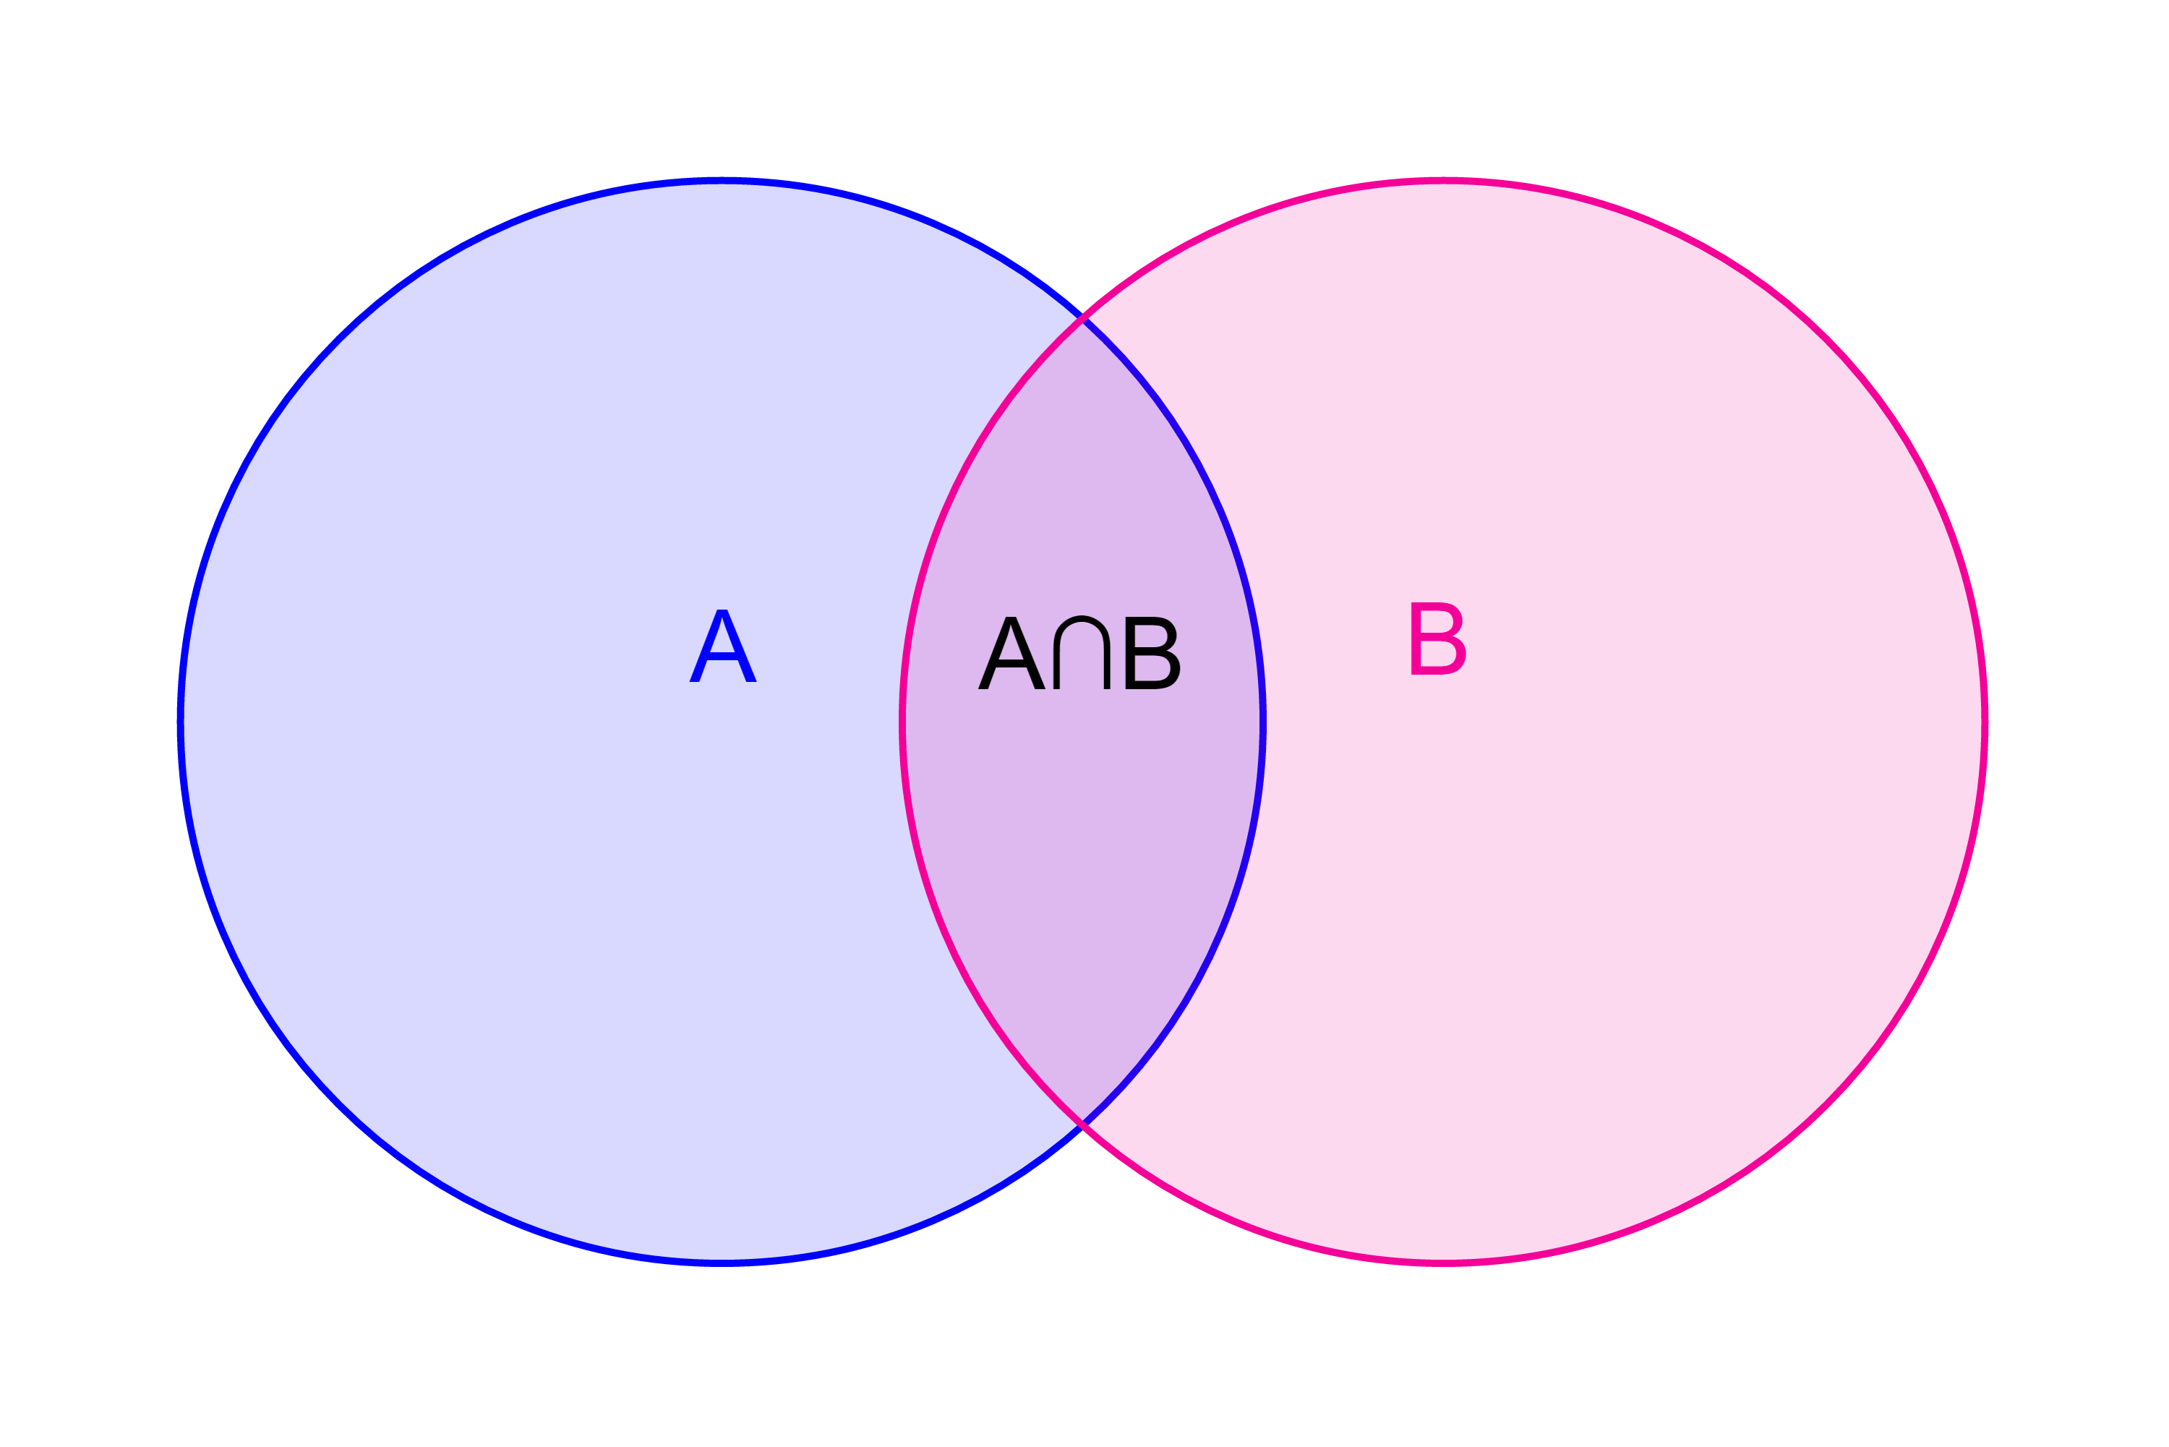

10-08 Probability
Compound Events
  1 event with 2 accepted outcomes
  $P\left(A∪B\right)=P\left(A\right)+P\left(B\right)−P\left(A∩B\right)$
  If $P\left(A∩B\right)=0$, then called mutually exclusive

Slide 57
10-08 Probability
You draw one card from a standard 52-card deck. What is the probability of drawing a heart or red?
Notes:
$$P\left(heart∪red\right)=P\left(heart\right)+P\left(red\right)−P\left(heart∩red\right)$$
$$=\frac{13}{52}+\frac{26}{52}−\frac{13}{52}=\frac{26}{52}=\frac{1}{2}$$

Slide 58
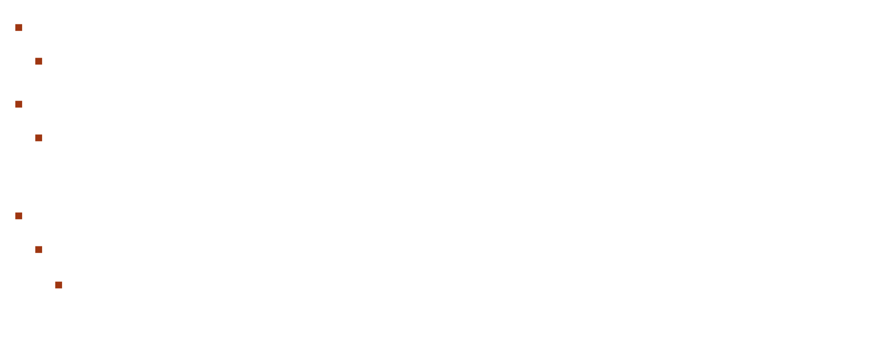
10-08 Probability
Multiple Events
  Two events with 2 outcomes
Independent – Event A does not affect event B
  $P\left(A and B\right)=P\left(A\right)∙P\left(B\right)$
Dependent – Event A does affect event B
  $P\left(A and B\right)=P\left(A\right)∙P\left(B | A\right)$
    Where $P(B|A)$ is the probability that B occurs given that A already occured

Slide 59
10-08 Probability
You draw 2 cards from a standard 52-card deck. What is the probability you draw a heart and a red? (a) with replacement (b) without replacement
Notes:
$P\left(heart and red\right)=P\left(heart\right)∙P\left(red\right)=\frac{13}{52}∙\frac{56}{52}=\frac{1}{8}=0.125$
$P\left(heart and red\right)=P\left(heart\right)∙P\left(red | heart\right)=\frac{13}{52}∙\frac{25}{52}=0.123$

Slide 60

10-08 Probability
Complement
  Opposite
  $P\left(\overline{A}\right)=1−P\left(A\right)$
  At least one $P(n≥1)$ is easier with the complement never $P(0)$

